Slide 1

Educational Travelers
Educational Traveling project

Slide 2
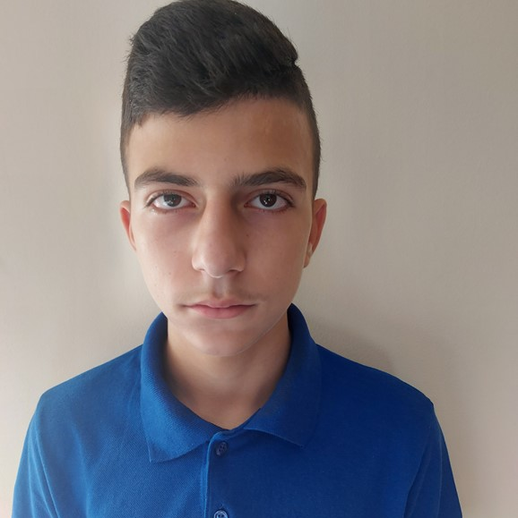
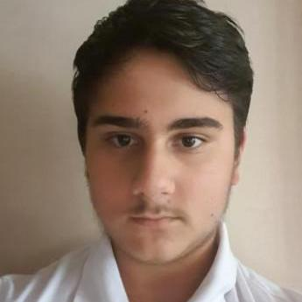
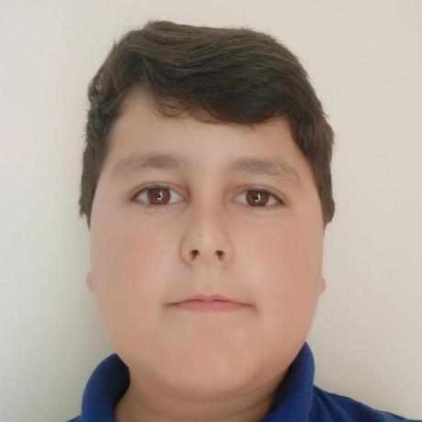
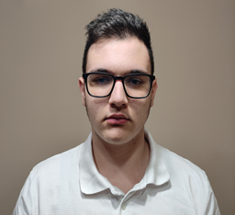
Our team
Rumen Petkov
Scrum Trainer
Bozhidar Boyadzhiev Backend Developer
Kaloyan Lambov Backend Developer
Dimitar Yoldov QA Engineer

Slide 3
Stages of work
01
02
Distribution of roles
Working on the project
03
04
Solving the problems
Presenting the final product

Slide 4
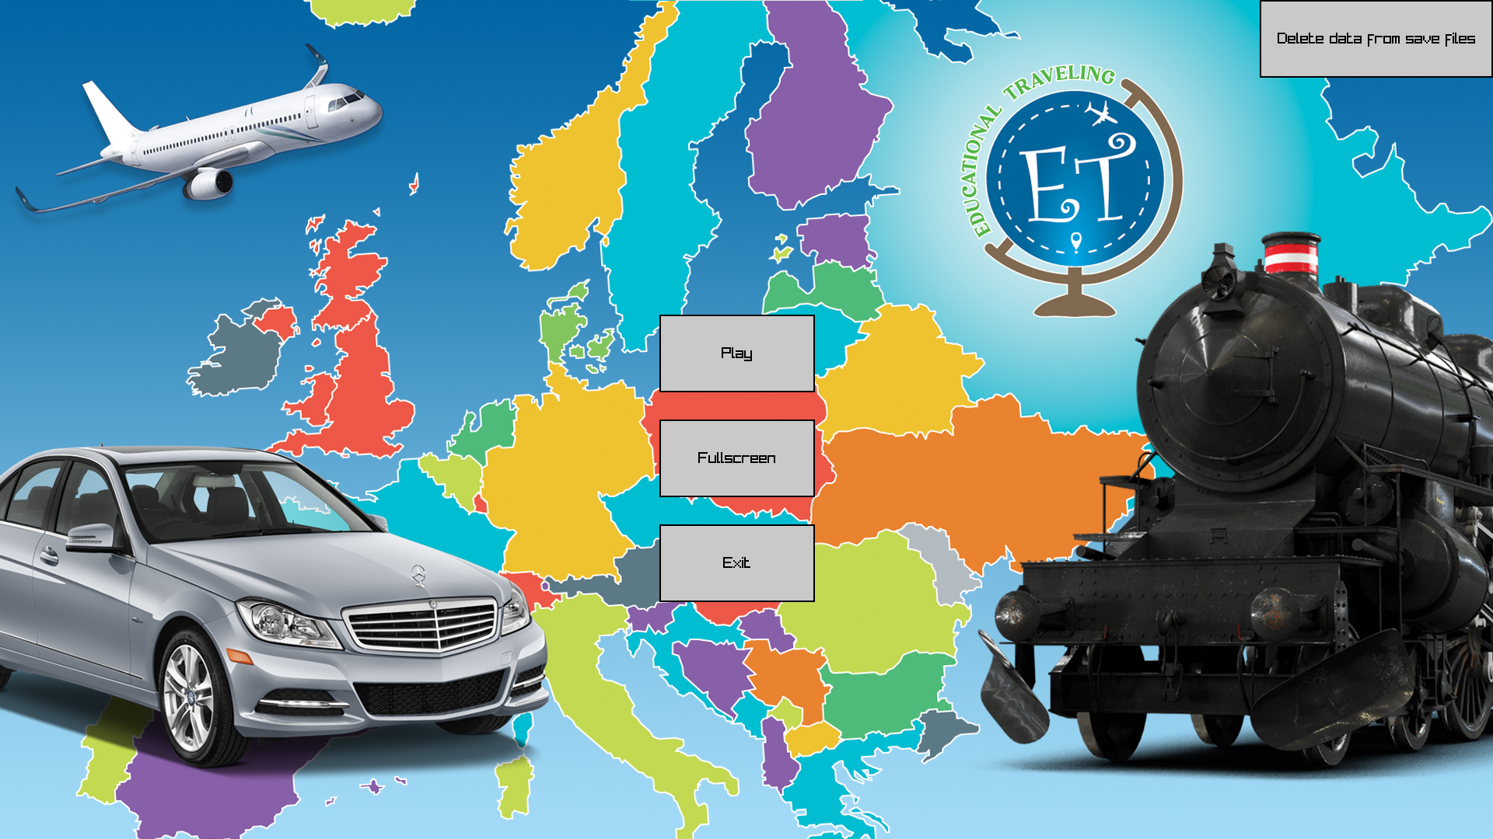
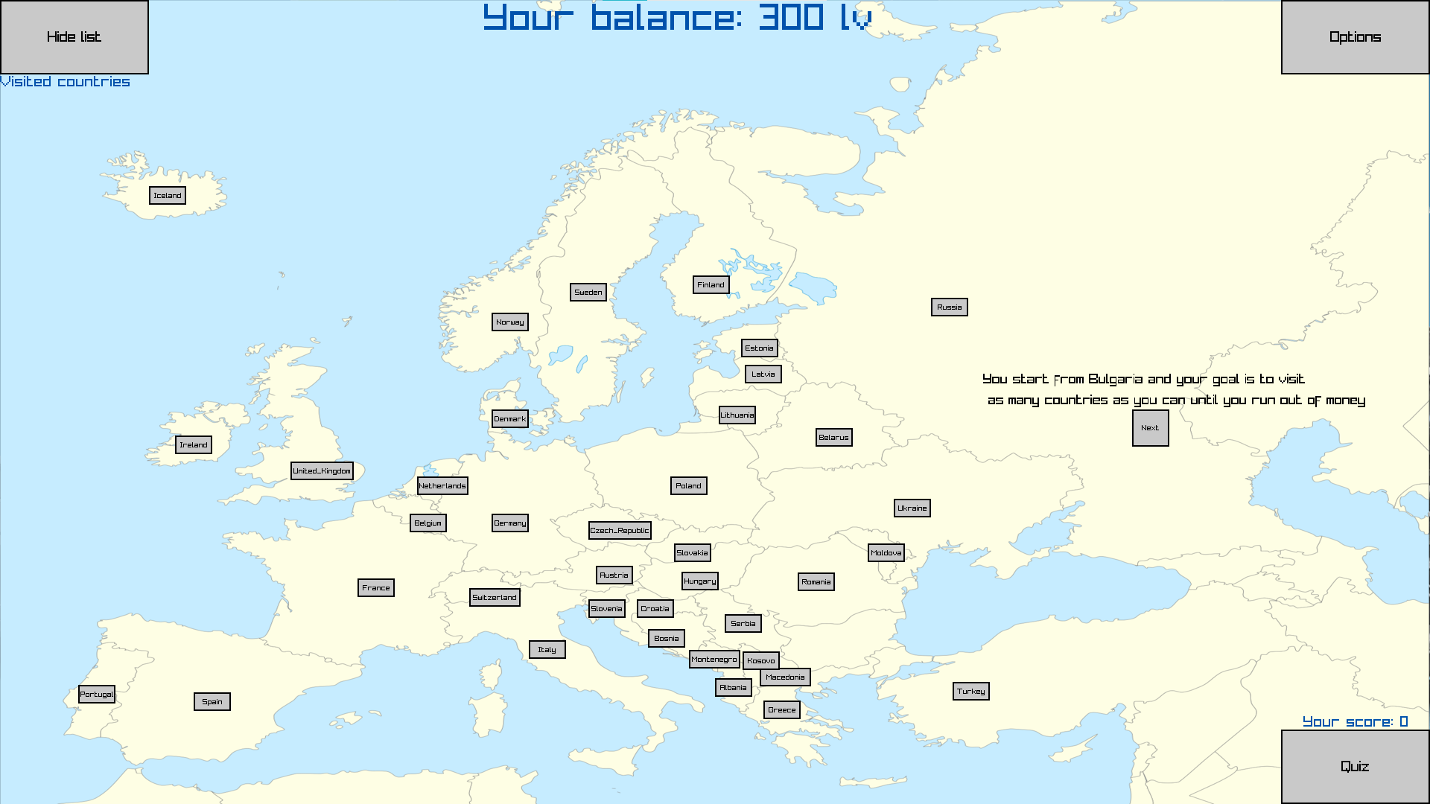
Our idea

Slide 5









Used technologies

Slide 6
Now let’s show you our game!
Whoa! That’s a big number, aren’t you proud?

